Slide 1
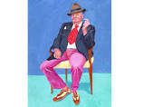
Still Life based on the Art of David Hockney
Charbonneau
PCHS
Art 2 and 3

Slide 2
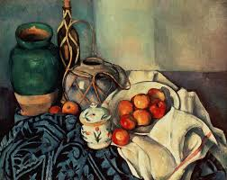
What Is A Still Life?
A still Life is art that shows non living objects often grouped together.
Objects Like:
Food
Flowers
Vases
Glass
And more
By Cezanne

Slide 3
History
Throughout the history of art still lifes were popular subject matter often taking on meaning. For example the painting below is a Momento Mori or warning that death is near and that you should be mindful of living a good life and not one of excess or greed.

Slide 4
Composition in a Still Life
Composition is the placement of objects within the picture plane. Its not only about how you set up the objects but how you put them on your paper.
Ask yourself?
How do you use the space on your paper? Be conscious of the Negative space as well as the positive space. If something is off usually the negative space spaes offer a clue!!!

Slide 5
Negative vs Positive
The blank or empty space around the objects.
The space the objects take up.

Slide 6
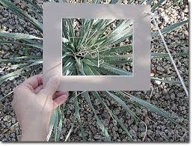
View Finder: The 1st Step to a good composition
Use a view finder or your hand to frame your composition. This helps block out the surrounding area. You can use your phone camera to do this but it is always better to draw from life so only use it for sketching and set up
purposes.

Slide 7
Tips for a good composition:

Slide 11
How to Sight or Measure 1 & 2
https://www.youtube.com/watch?v=HQgjZbGK8Yc
By Paul Priestly on sighting
https://www.youtube.com/watch?v=Zqi7S74ouqw
On triangularization sighting

Slide 12
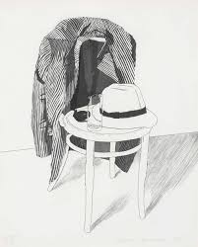
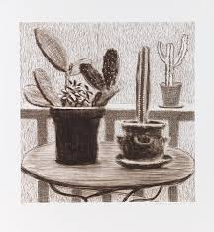
Perspective Drawing and looking at Negative space lead to an accurate drawing!

Slide 14
David Hockney

Slide 15
About him…
David Hockney is a well known painter who has been in the art scene since the 1950’s.
He is considered to be the most influential British artist of the 20th century.
He spends much of his time in California and so many of his paintings have the California “feel.”
He died in 2013.

Slide 16
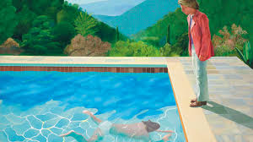
For years he painted portraits and double portraits of friends, lovers, and relatives just under lifesize in a realistic style that adeptly captured the likenesses of his subjects. He also painted over 300 portraits of himself.
This painting is
in the news
because it is set
to sell for 80
million dollars!

Slide 17
The Panama Hat
David Hockney’s Still Life etching, “The Panama Hat,” shows the illustrative style he developed in the 1960s, marked by an emphasis on crisp lines and images isolated within near-empty fields.
Over the course of his long career, Hockney made numerous conventional portraits of Henry Geldzahler, his friend and curator of twentieth-century art at The Met. This portrait stands out among the group, as Gehldzahler’s jacket, pipe, and hat represent their absent owner.

Slide 18
Assignment
Draw from a still life inspired by the Panama Hat. Include the entire chair as Hockney would have. Keep lines simple and organized. Notice lines are smooth and not sketchy.
Use what you learned in the powerpoint like sighting and comparing positive and negative space when drawing. Have some value but keep it in the style of Hockney.
Use graphite and tape paper onto a large board…do not draw flat!

