Slide 1
Tips for Creating a Great Art Sketchbook (Art 3 & 4)
Amy Charbonneau
Piedmont Classical High School

Slide 2
What is an Art Process Sketchbook ?

Slide 3
What is an Art Process Sketchbook?
An Art Process Sketchbook is a sketchbook that helps an artist document the process of making an artwork. It should be visually appealing and informative as it takes the viewer from the basics of the idea, through problem solving, sketches, the choosing of materials/mediums, all the way through to the end product which includes the artists critique.

Slide 4
What’s that again?
Your process book should include:
Notes describing the basics of your idea (inspirations including artists works &/or images important to your idea or concept).Art History.
Early sketches showing problem solving.
More notes documenting your experiments with materials/mediums.
An image of your final artwork.
Artists critique.
Use interesting fonts, borders and design elements to keep every page aesthetic.

Slide 5
Our Sketchbook Rubric

Slide 6
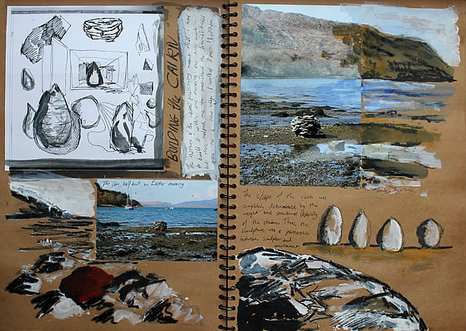
Examples….
Research

Slide 7
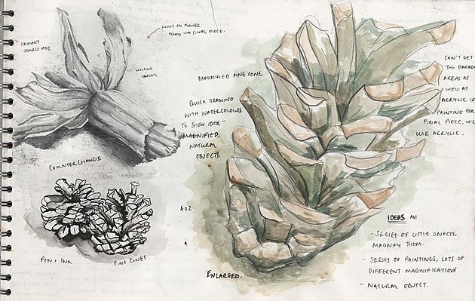
Detailed Example….

Slide 8
Here is an example of a two page layout where the has an end product (left) and images of inspiration along with written details in a visually interesting format.

Slide 9
Very detailed example that documents process techniques with inspiration…

Slide 10
Process books can be interactive to show your formative ideas…
Closed
Open
This artist created 3 compositional layout & placed them in book to show how her ideas flowed.

Slide 11
Your goal is to document your thought process…interactive pages are great.

Slide 12
Including Final Planning
This example is also interactive

Slide 13
When creating pages don’t be afraid to use color!!! Paint pages then add information on top Remember- Never close a page if its still damp!!!!
Get creative & Have Fun!!!!!! If you mess up, paint or post it over it!

Slide 14
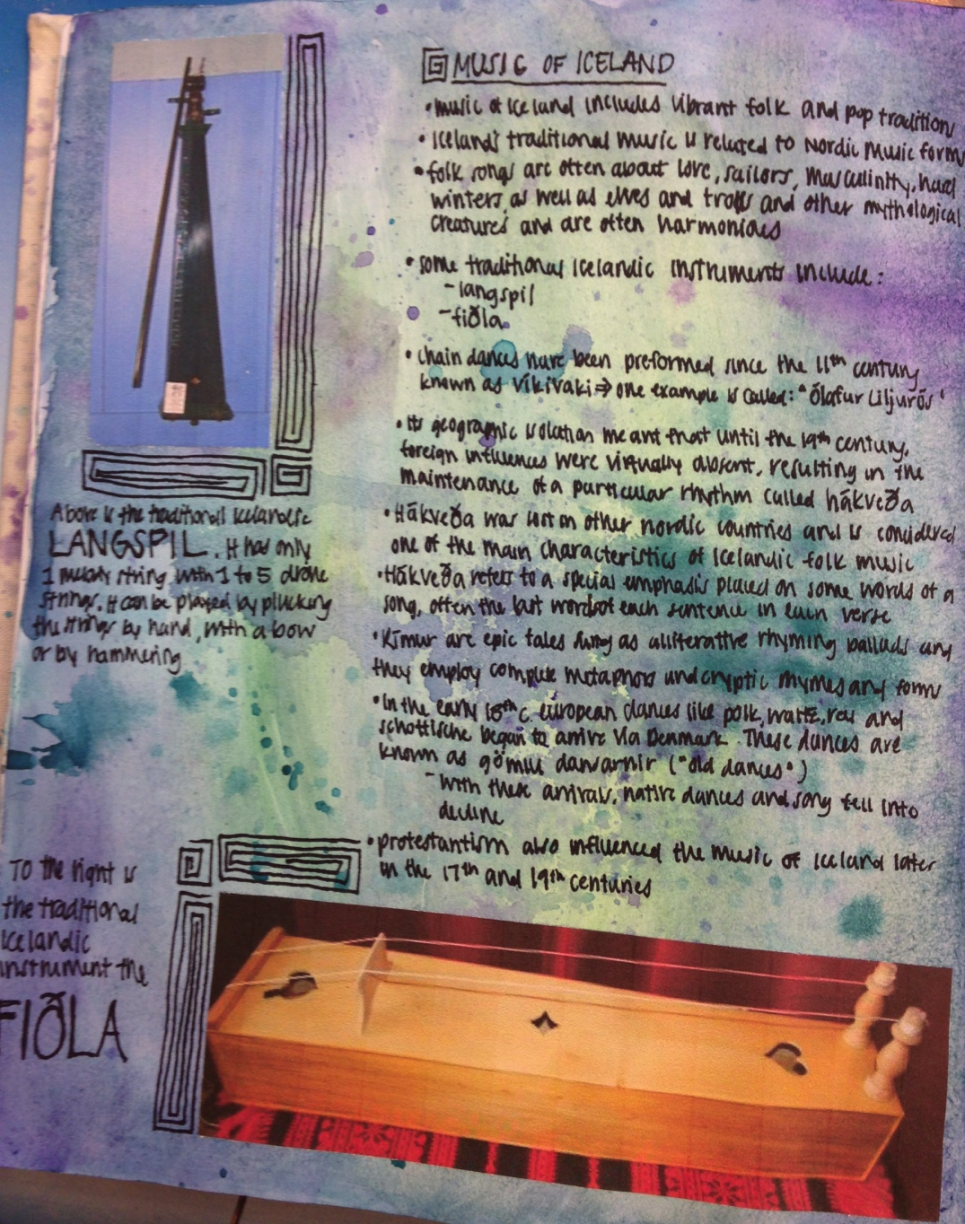
This is an example of an Art 4 students notes on a piece based on the music of Iceland.

Slide 15
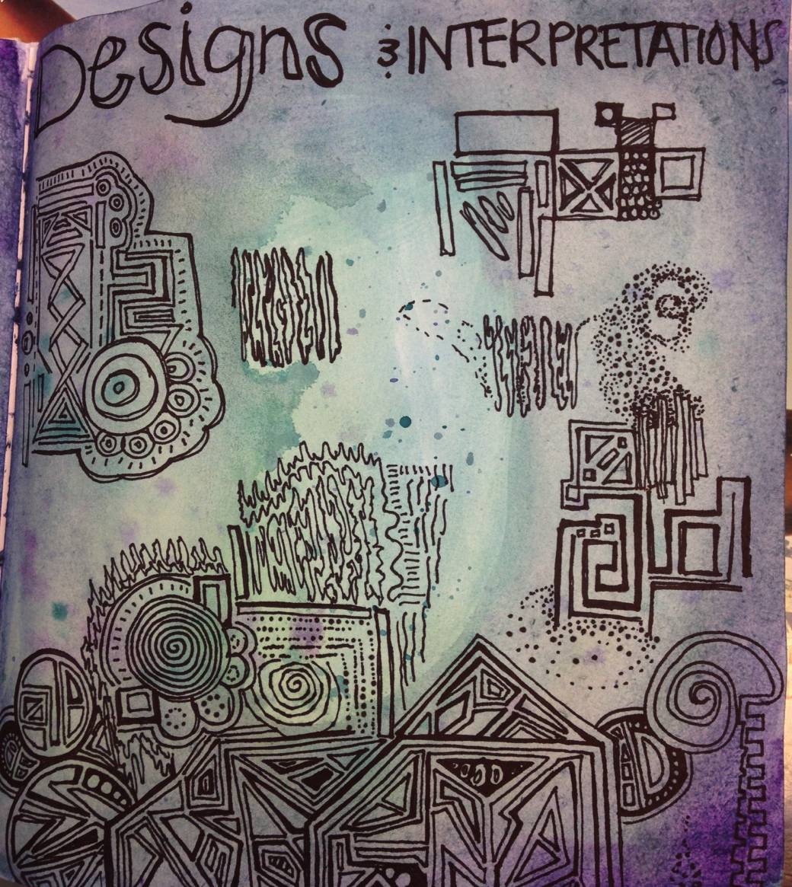
Here are her examples of problem solving/sketches….

Slide 16
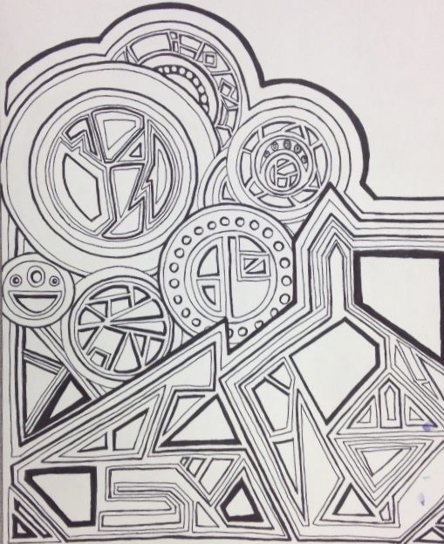
Here is her final…..

Slide 17
End with a Critique or Reflection

Slide 18
The Art of Critique Writing:
How to write about your Art
Descriptive Paragraph:
State Objective
Describe the process and what your artwork looks like.
Include some vocabulary you can use
Reflective:
Discuss how your artwork relates to the assignment.
Discuss how looking at class examples inspired your own work.
Discuss how you changed your final artwork from your initial sketch.
Interpretation:
Discuss why you chose the idea for your assignment.
Discuss a few things that you learned from the art making process.
Evaluation:
Restate what your goals were briefly. Did you achieve them? How?
(Use Your Art Terms)

Slide 19
Any Questions?

